Slide 1
TRAINING PRESENTATION
2021-2022
Compressed Buttress and Tensioned Restraint Stabilization/Lifting

Slide 2
Objective
To understand struts and their proper use.
To increase the student’s knowledge in the use of Res-Q-Jack struts for stabilization and lifting in motor vehicle accidents or other applications.
To understand the physics of stabilization in relation to shapes, movements, weights and forces and to see how they apply in stabilization and lifting operations.

Slide 3
Table of Contents
Part I: Basic Strut Information
Part II: Strut Stabilization Concepts
Part III: Strut Lifting Concepts
Part IV: Strut Lifting Scenarios
Extras:
Part V: Calculating Weights
Part VI: Wood Cribbing, Ratchet Strap, Chain Information
Part VII: RQJ Product/Equipment Overview

Slide 4
Part I:
Basic Strut Information

Slide 5
What is a strut?
A strut is a rod or bar designed to resist compression
We further define a strut as a “system” consisting of tubing, extensions, base and head/end fitting
Each time you add a component you change the capacity of the system/strut
When comparing struts and working load limits (WLL), be sure you know what each manufacturer defines as a strut and how they test it
Some refer to a strut as the tubing only, not including the head and base

Slide 6
Strut Design Factors
Material and Properties
Diameter
Hollow vs. Solid Inner Tube
Telescopic vs. Fixed Length (i.e. Wood 4x4)
Number of Joints and Fit Clearance
Overlap Between Joints
Base/End Fitting Design, Fixed vs. Pivoting

Slide 7
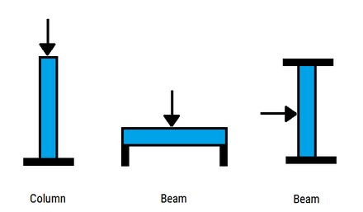
Strut Loading
Struts are loaded axially at the two ends, unlike beams which are transversely loaded on the side
A column is one example of a strut. We often interchange the words strut and column, even though a column generally refers to a vertical support.

Slide 8
Warning: DO NOT Side-Load Struts
We refer to beam loading a strut as side-loading. There should always be space between the strut and the object you’re stabilizing or lifting.
Certainly a strut will have some strength as a beam, however, we do not test or characterize a strut with regards to transverse loads. There are far too many variables involved to adequately determine the load.
RQJ strut working load limits refer to column load capacity.
Side-loading your strut will cause damage to your equipment or lead to injury.

Slide 9
Strut Testing
How a strut is tested is critical
A strut should be tested as it is used in the field with all components involved in the system
A “strut” tested without a head or base will have a much greater test capacity than one with them
A strut with a pivoting head has a much lower capacity than a strut with a fixed head

Slide 10
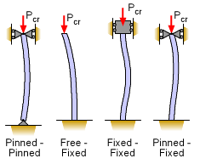
Strut Testing
A strut’s boundary or end conditions/freedoms/restrictions play a big role in a strut’s capacity
These conditions are determined by the end fitting/head/base used on the ends of the strut where the loading occurs
A pivoting end will allow the strut end to freely rotate, where a fixed end restricts strut end rotation
The more freedom a strut end has to rotate, the lower the column working load limit, thus a strut with fixed ends will hold more than a strut with pivoting ends
Reference: https://www.ecourses.ou.edu/cgi-bin/ebook.cgi?doc=&topic=me&chap_sec=09.2&page=theory

Slide 11
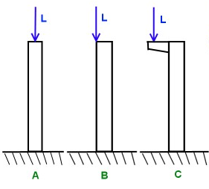
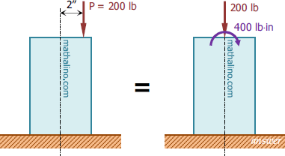
Offset Loading
Where the load is positioned on the strut head is also very critical
Be sure to know the impact of offset loading
A strut with a centered column load has a much greater capacity than a strut loaded eccentrically/offset
A concentric (centered) column load is a compression problem. An eccentric (offset) column load is both a compression and bending problem
Reference: https://www.tapatalk.com/groups/the911forum/ozeco41-s-response-to-a-challenge-to-explain-initi-t779-s15.html
https://www.mathalino.com/reviewer/engineering-mechanics/255-equivalent-loads-compression-member-eccentric-load

Slide 12
Strut Loading— Concentric vs. Eccentric (Column Center vs. Offset)
A good rule of thumb is to assume you lose 50% of your strut’s concentric column capacity by moving the load 1.5” off center

Slide 13
Comparing Apples and Oranges
Some struts are rated at 4:1 safety factors with very high WLL’s
Be sure you know how these numbers were developed
Did they only test the tubing without heads and bases? Would you ever use a strut that way?
What type of heads were used—fixed or pivoting?
Does the labeled capacity of your strut indicate load position—concentric or eccentric?

Slide 14
Part II:
Strut Stabilization Concepts

Slide 15
Why Do We Stabilize?
To ensure vehicles/objects are safe to work around
To ensure the safety of not only the patient, but the first responders!

Slide 16
Stabilization Assessment
What do we need to consider?
How stable is the vehicle?
How much stabilization is required?
What equipment is needed?
Is lifting necessary?

Slide 17
Shapes and Geometry: Why They Matter
We need to recognize the different shapes we’re creating with straps, chains, struts, objects, etc.
Start seeing things as simple shapes
Eliminate the background noise
Geometry matters because it determines the restriction or freedom an object has to move

Slide 18
Triangles 101 Triangles are the basic foundation for stabilization
3 sides
Triangles are unique in that they are the only rigid 2D shape making them the strongest and simplest 2D shape
All other shapes can be deformed with a simple push

Slide 19
Conventional Triangles
Rigid 3 bar shape
All parts move/rotate together
All parts will handle compression or tension
All segments are fastened to each other
They will not separate at the joints
However, we’re not typically working with a conventional triangle…
Conventional Triangle

Slide 20
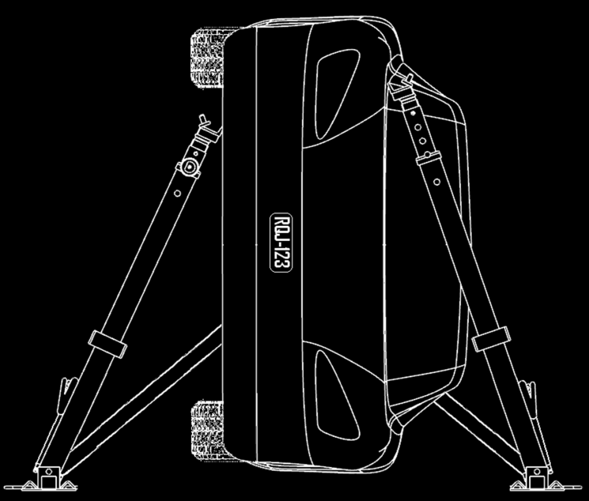
Unconventional Triangles
STRUTS work in COMPRESSION ONLY
The strut head is not fixed to the car
The strut can separate from vehicle
STRAPS work in TENSION ONLY
STRAP will collapse or fold in compression
1
2
3
Vehicle
1
Strut
2
Strap
3

Slide 21
Visualize the Triangles
CAR
=
1
2
2
2
1
3
3
3
As long as the vehicle or object is solid then we can assume a straight line between a strut and its base strap connection.
Vehicle
1
Strut
2
Strap
3

Slide 22
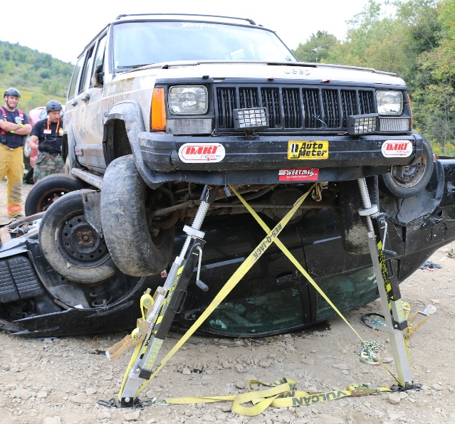
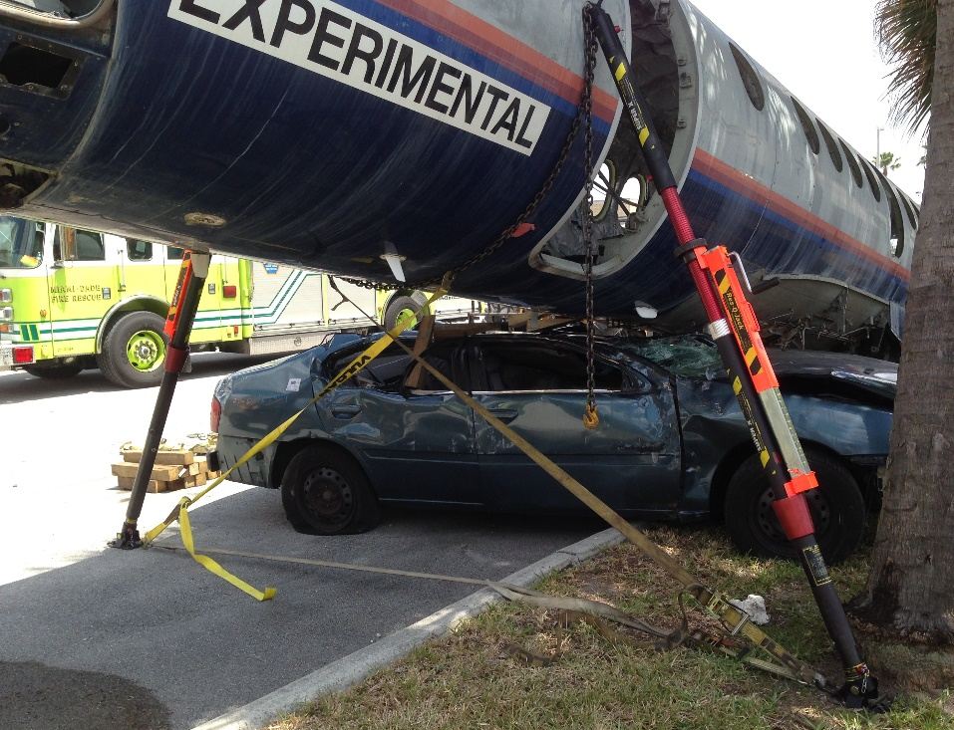
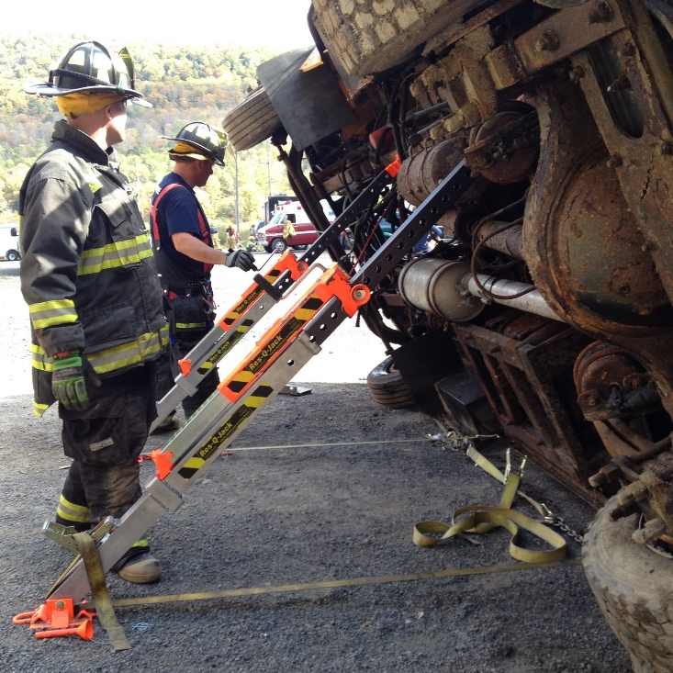
Visualize the Triangles
=

Slide 23
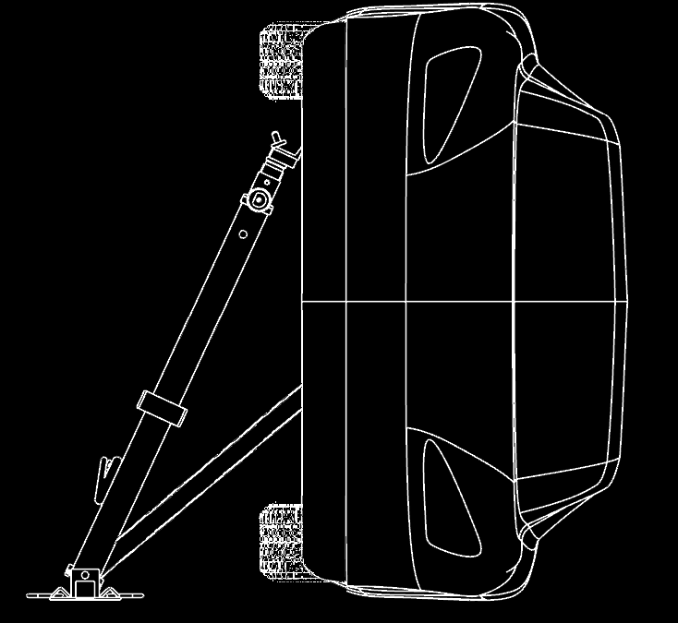
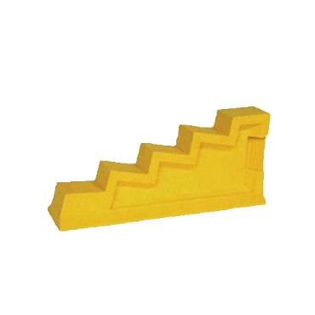
Unconventional Triangles 101 Use caution with single-sided setup
A strut and strap placed on single side will create a twisting effect
Cribbing at opposite side is often removed when cutting roof off
Cribbing is necessary, but increases the footprint minimally
Caution: Inadequate counteracting forces are present in this setup

Slide 24
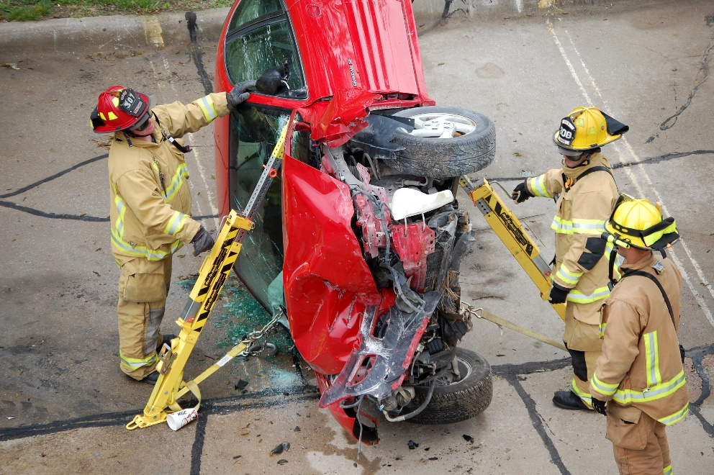
Unconventional Triangles 101 Two struts are better than one!
The push of one strut is countered by the push of the opposite strut
The pull of one strap is countered by the pull of the opposite strap
Struts should be aligned on both sides of vehicle
Counteracting forces are better

Slide 25
Alternatives to Opposing Struts
Tie-Lines, Stakes, Pickets, etc.
If you’re unable to set up struts on both sides of the vehicle, use a tie-line (blue line) to resist the strut from pushing and to keep the vehicle from rolling away
The tie-line should be attached to the object above the strut head in this scenario to create counteracting forces.
Note: If insufficient ground to vehicle contact, additional restraints may be required to prevent vehicle from sliding

Slide 26
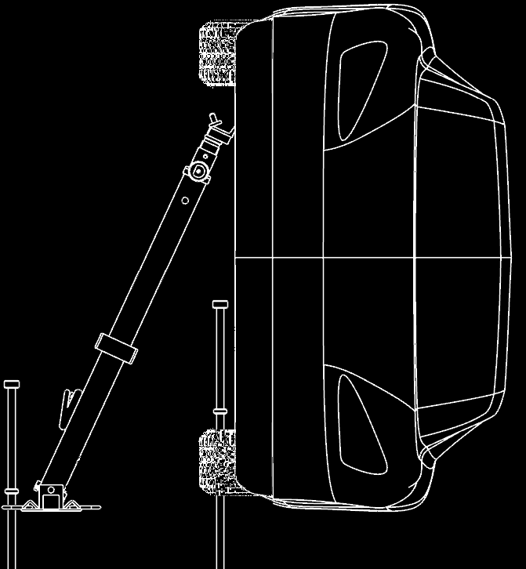
Alternatives to Opposing Struts
Tie-Lines, Stakes, Pickets, etc.
You can also use stakes at strut base and vehicle instead of a strap
*If not using a strap, stake both the base AND the vehicle

Slide 27
4-Sided Shapes 101
Reference: https://slideplayer.com/slide/2329469/

Slide 28
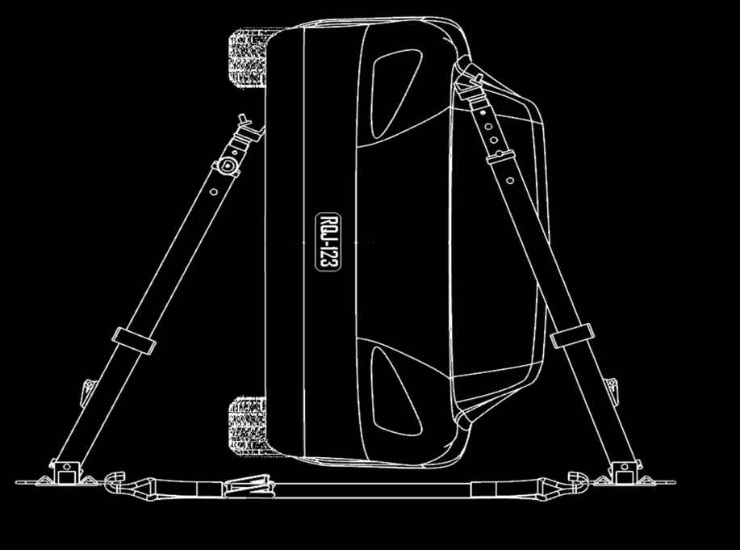
4-Sided Shapes 101
Use caution with 4-sided (or more) shapes!
No forces restricting the bottom of the vehicle from moving (straps)
Vehicle can potentially shift at the bottom
The shape itself can shift since it’s not a triangle
1
4
2
4
3

Slide 29
Visualize the 4-Sided Shape
1
1
CAR
=
4
2
4
2
3
3
Vehicle Strut Strap Strut
1
2
3
4

Slide 30
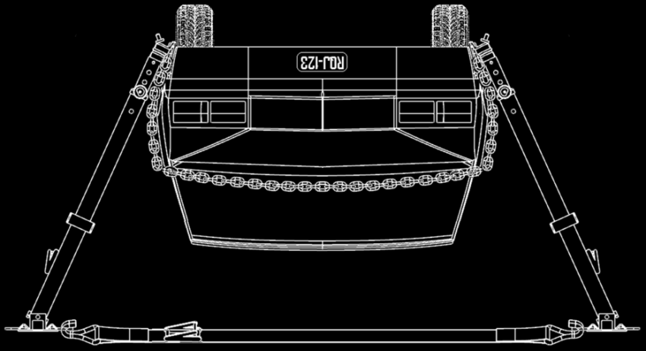
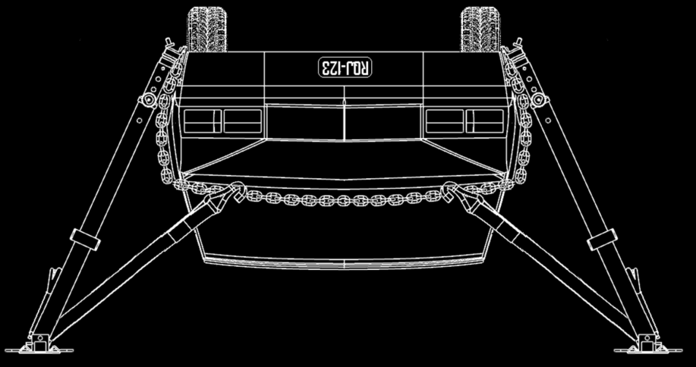
Know the Difference—It’s Critical!
Caution: 4 sided shape!
Good
Best!

Slide 31
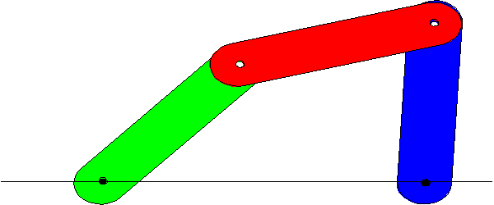
Know the Difference—It’s Critical!
These visuals represent an object with struts placed without triangles/sway straps being used

Slide 32
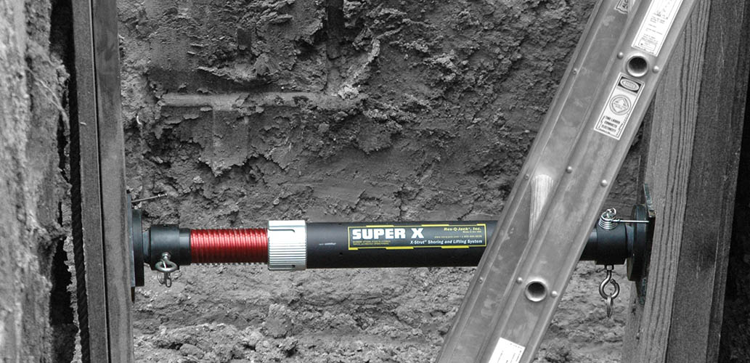
Strut Orientation
Typically, we consider using a strut in a vertical position for collapse, in a horizontal position for trench rescue and at an angle with a strap attached for vehicle stabilization
Let’s eliminate this “standard” we’ve generated
Let’s also clear up the misconception that a strut has a different strength at different angles

Slide 33
Strut Loads VS. Angles
A strut’s strength is the same regardless of how it’s oriented (gravity is negligible)
What changes is the object load depending on the strut attack angle
The load on a strut placed at a 45° angle is approximately 1.5 times the same load where the strut is at a 90° angle. See following figure and chart

Slide 34
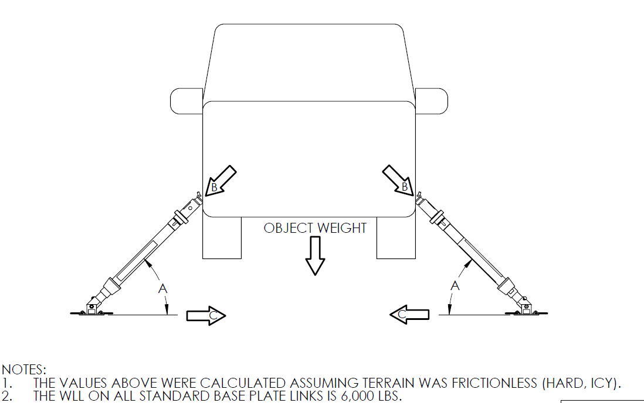
Strut Loads VS. Angles

Slide 35
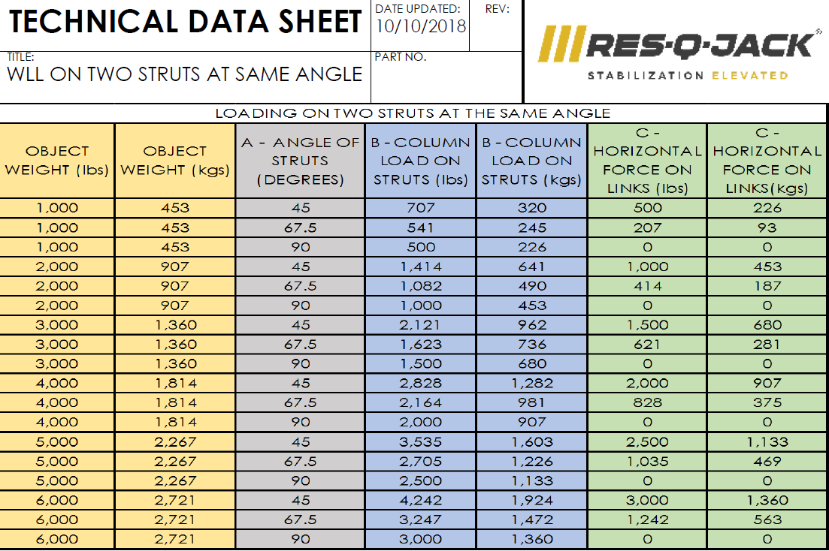
Strut Loads VS. Angles

Slide 36
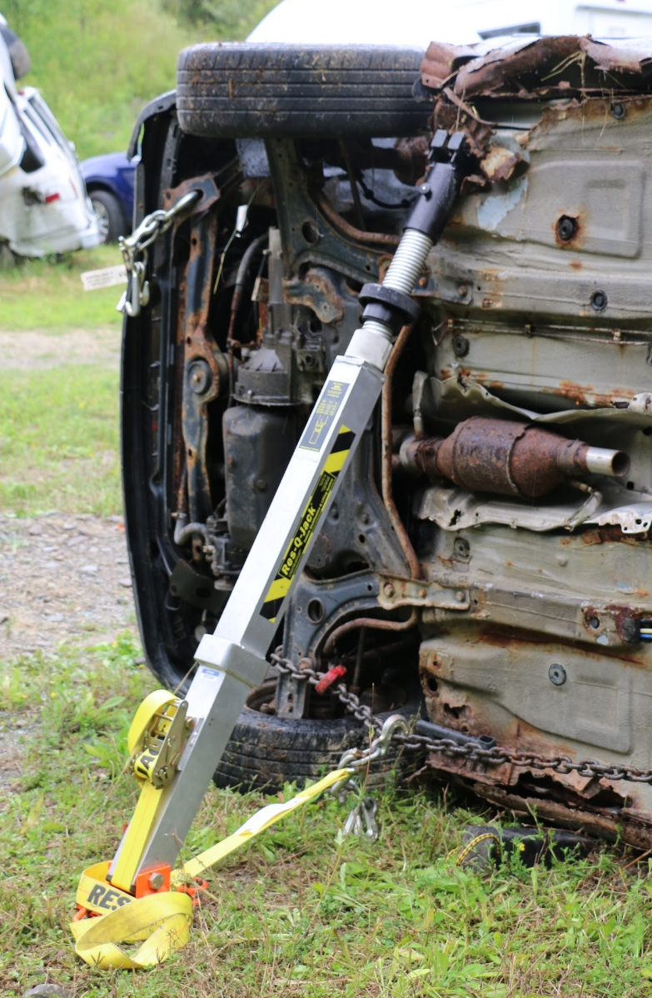
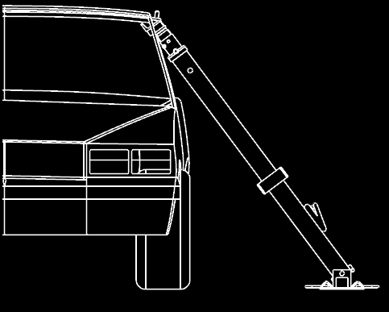
Strut Orientation: Angled Struts
Angled struts require a stake or a strap to prevent the base from sliding
A strap attached to the object will also prevent the object from sliding away from the base and create our triangle desired for stabilization
For basic angled strut setup on flat ground, place the strut base an arm’s length away from the car at a 45-70° angle
Arm’s Length
50° - 70° Angle

Slide 37
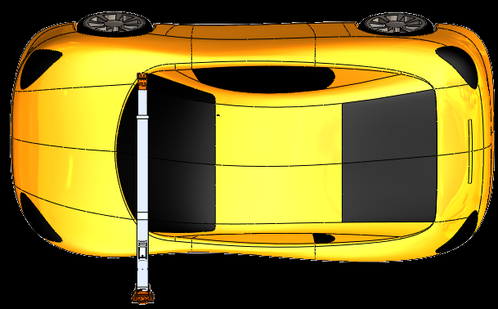
Strut Orientation: Angled Struts
Do NOT hook straps too high. Straps must be hooked low to restrict movement and create the triangle we are looking for.
Notice in the right picture that there is no triangle. This is more like a door hinge that could allow strut base to swing or slide out.

Slide 38
Strut Orientation: Angled Struts
With a SINGLE base restraint, position strap in line with strut
HERE
NOT HERE
NOT HERE
STRAP IN LINE WITH STRUT
If unable to use a single strap straight back to the object, use 2 straps to counter the pull on the side of strut or pull on the vehicle (one strap angled off each side of the strut as shown). Straps do not have to be angled exactly the same as long as you are creating counteracting forces.

Slide 39
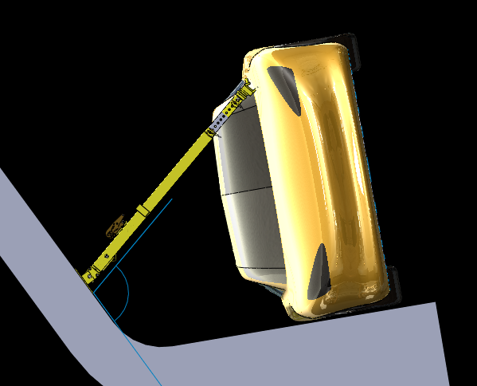
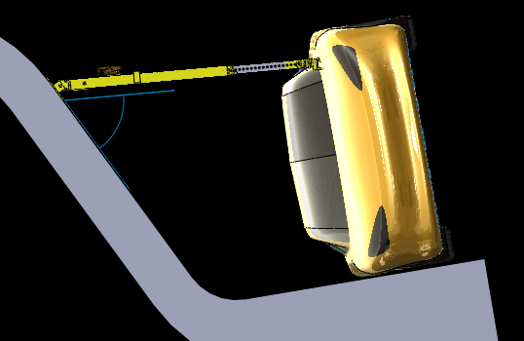
Strut Orientation: Horizontal Struts
Terrain and vehicle position may play a role in determining strut placement
Pay attention to the ground/strut angle. The strut can move if placed at a bad angle.
Angle greater than 90⁰ BAD
Angle less than 90⁰ GOOD
Strut may swing out when strap is tightened
Strut should bear into ground when strap is tightened

Slide 40
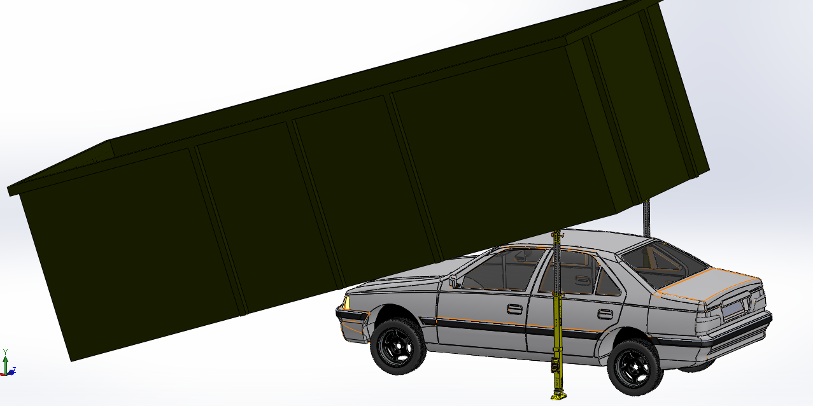
Strut Orientation: Vertical Struts
Less equipment
Less time
Minimizes load on strut
On flat ground a vertical strut will most likely not need a base strap
The name of the game is COUNTERACTING FORCES. If you do attach any base restraints, they must be placed as a pair working in COUNTERACTING DIRECTIONS to prevent strut base movement
Base stakes may not be necessary, but are a good idea to prevent base shifting
Control shift or sway of object with stakes and/or tie-lines

Slide 41
Envision 3D Stabilization
Look at the big picture— rotation, sliding, tipping, etc.
For example, often times we’ll focus on a side resting car tipping to the wheels or to the roof and not consider twist or slide
View from all directions—where is the possible movement?
Use stakes, pickets, tie lines, etc. to prevent movement

Slide 42
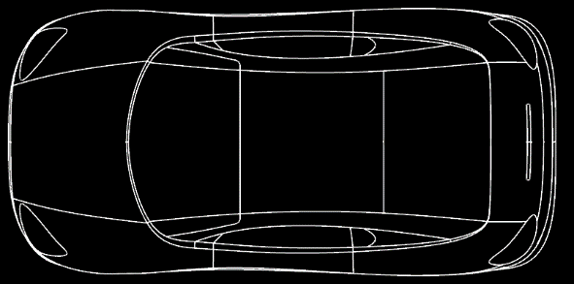
Tie-Lines
Tie-lines should act in an “equal and opposite” way to avoid twisting or shifting of the vehicle
UNSTABLE!
In this figure all tie-lines are acting in a way that would cause counter-clockwise rotation
Movement may not be realized while the object is on the ground, but may appear during a lift

Slide 43
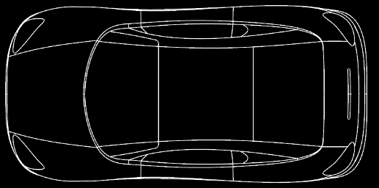
Tie-Lines
Notice that the lines are now opposing. The vehicle is stable and will not rotate
STABLE!
Everything looks great, right? Things may look fine from this angle, but could we be missing something?

Slide 44
Tie-Lines
Envision all angles and possible movements
UNSTABLE!
Vehicle now has the ability to pitch,
even though it may look stable

Slide 45
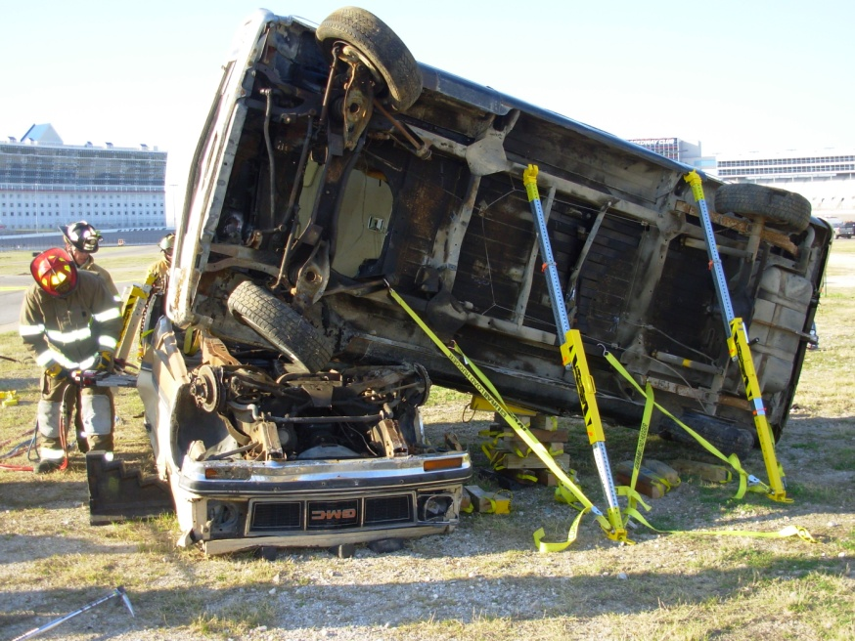
Multiple-Object Considerations
Overrides
Properly “Marry” Vehicles
Caution making triangles
Be aware of suspension components and treat appropriately

Slide 46
Purchase Points
Purchase Points are the strut engagement locations on a vehicle or object.
This is where the force of a strut would be applied to the object.
You need to consider the load you will be placing on the object itself to determine the best spot for your purchase point so you don’t overload that area.
Piercing sheet metal should be a last resort because of its weaker tendency and necessity for violent impact on an unstable object.

Slide 47
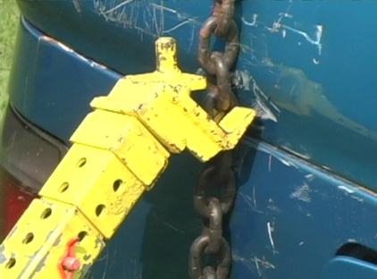
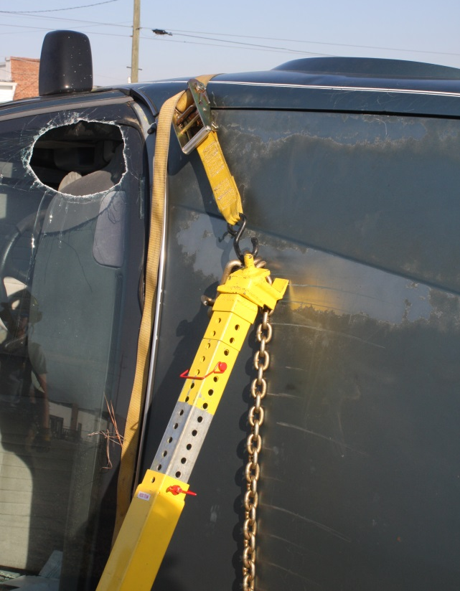
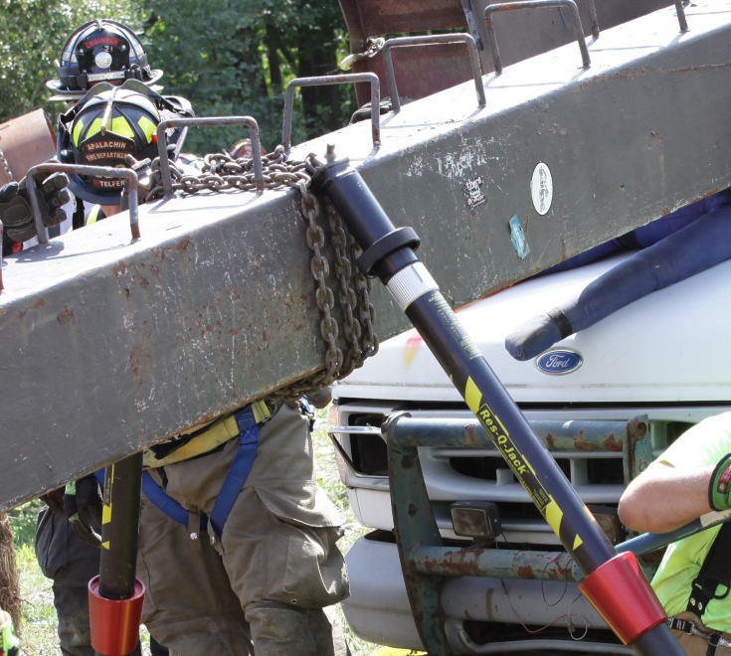
Purchase Points
Chain Wrap and Chain Grab

Slide 48
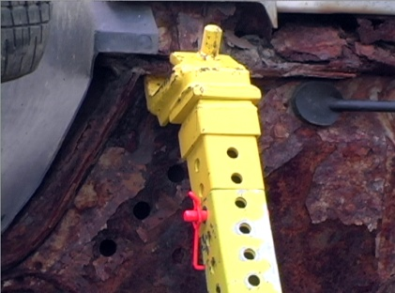
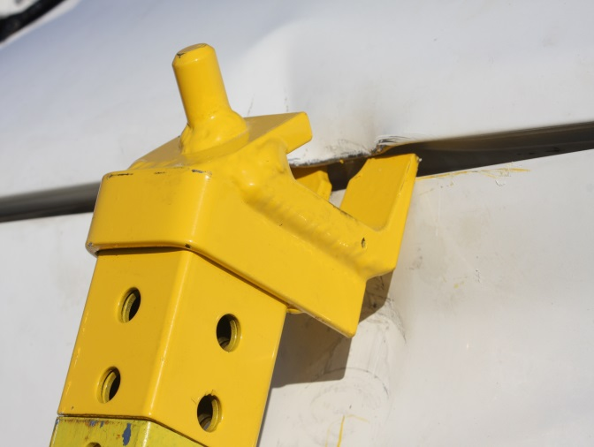
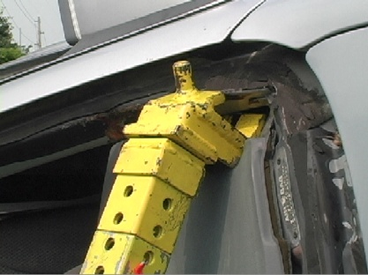
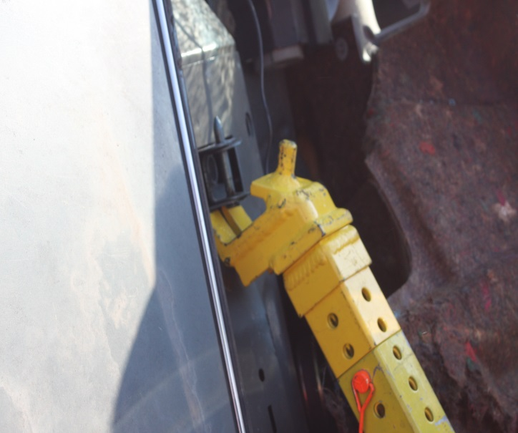
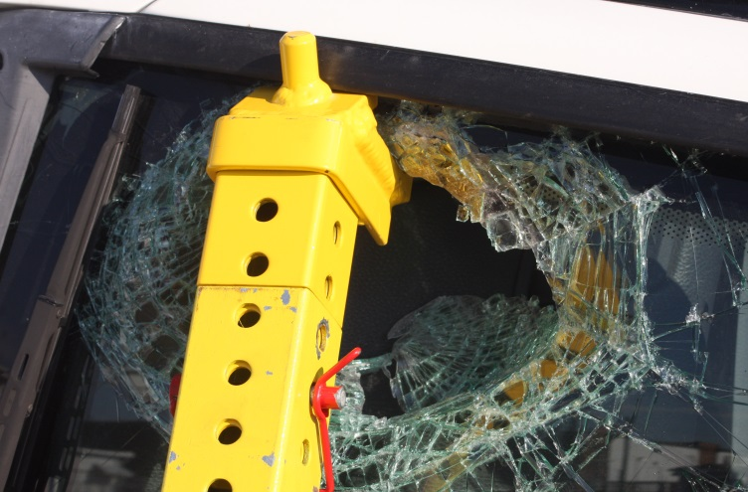
Purchase Points
“C End”

Slide 49
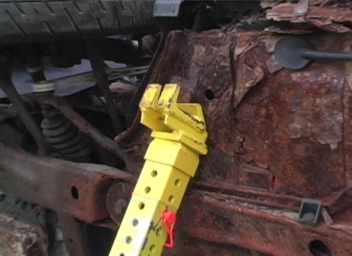
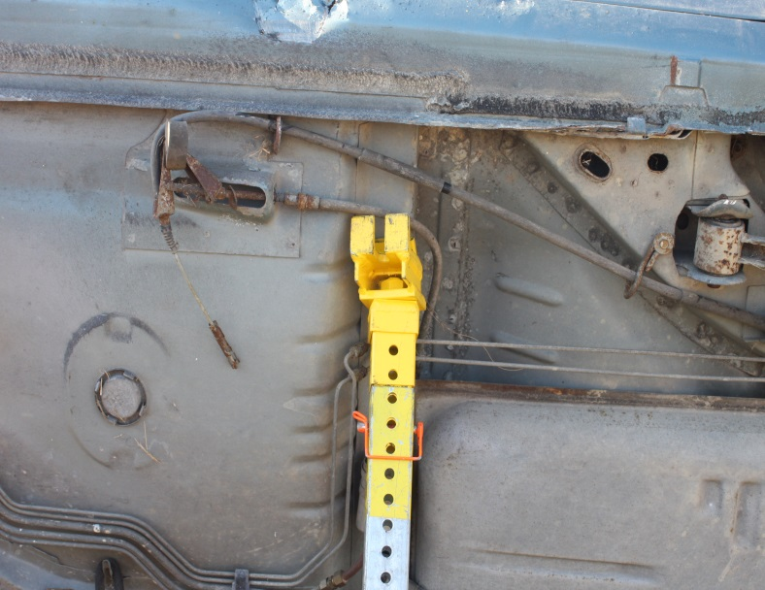
Purchase Points
Round Point to factory holes in frame

Slide 50
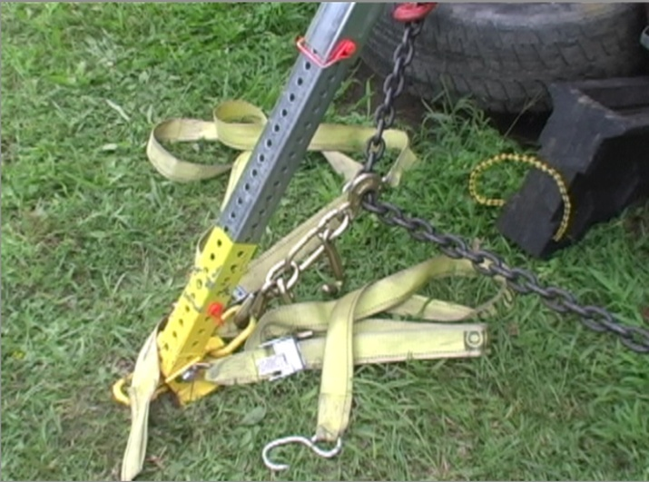
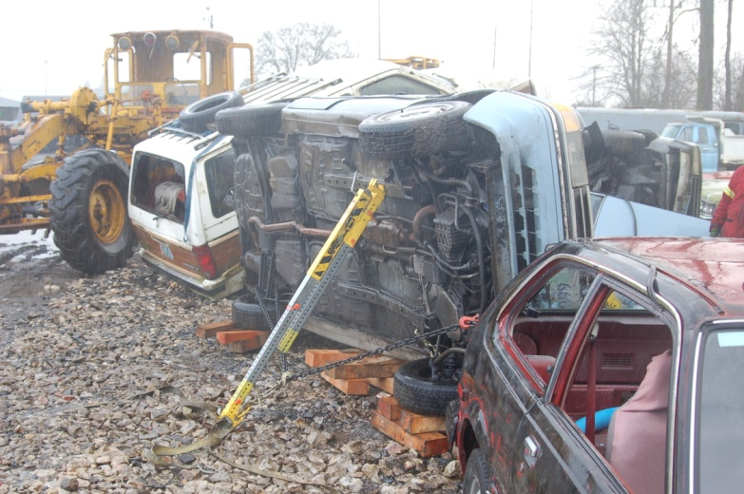
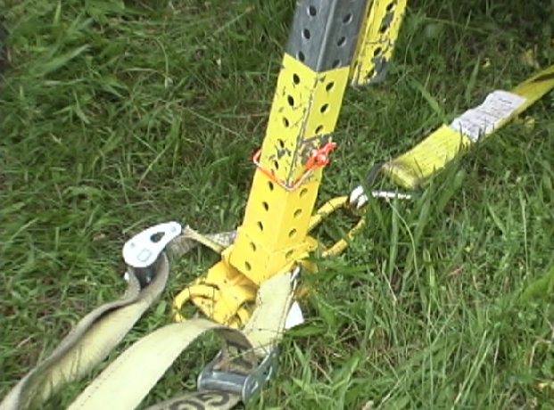
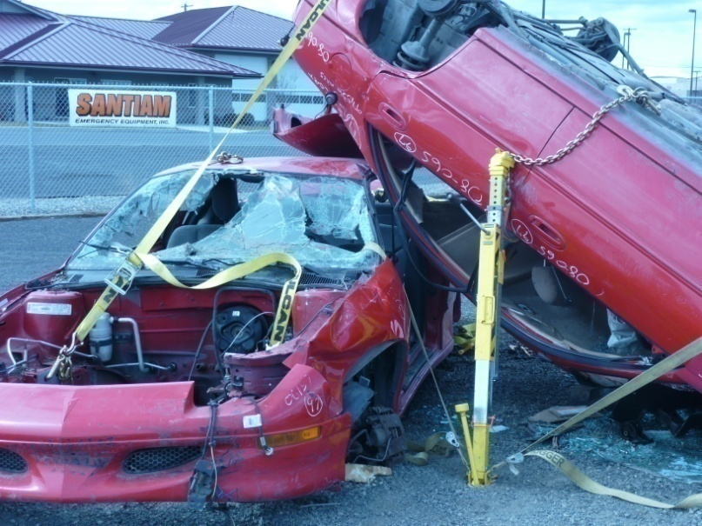
Base Restraints
“D” Ring Cluster to Chain
Both ends of chain are secured to under carriage of car also using a cluster from the D Ring to the chain
Ratchet Strap to object or Base to Base or D Ring to D Ring
Stake Base

Slide 51
Part III:
Strut Lifting Concepts

Slide 52
Lifting Basics
Why/When Should You Lift?
Partial ejection or entrapment
Relieve pressure on roof posts with an overturned vehicle
Create working space to access patients
Speed up operation to give the patient a better chance
Remove from overhead hazard with an override (ex. car on car)
Why Lift With Struts?
Need to stabilize load during lift (even if using lift bags)
High engagement w/ struts with increased footprint
No need to “dig holes” under the load
Quick and easy
We are complimenting cribbing, not replacing it. Remember to lift an inch, crib an inch.

Slide 53
Lifting Basics
Triangles are great for stabilization
Triangles are not so great for lifting and must be incorporated properly
search YouTube “strut failure”
Lifting against a tight triangle can result in dangerous tension buildup or strut failure
Tension management is critical
Options: short lifts, crib and reset, dual straps or single “leash” straps with 4-sided shape combination, outrigging, etc.

Slide 54
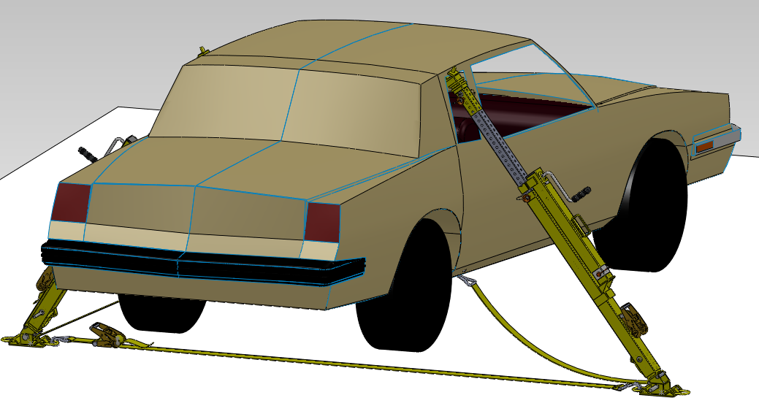
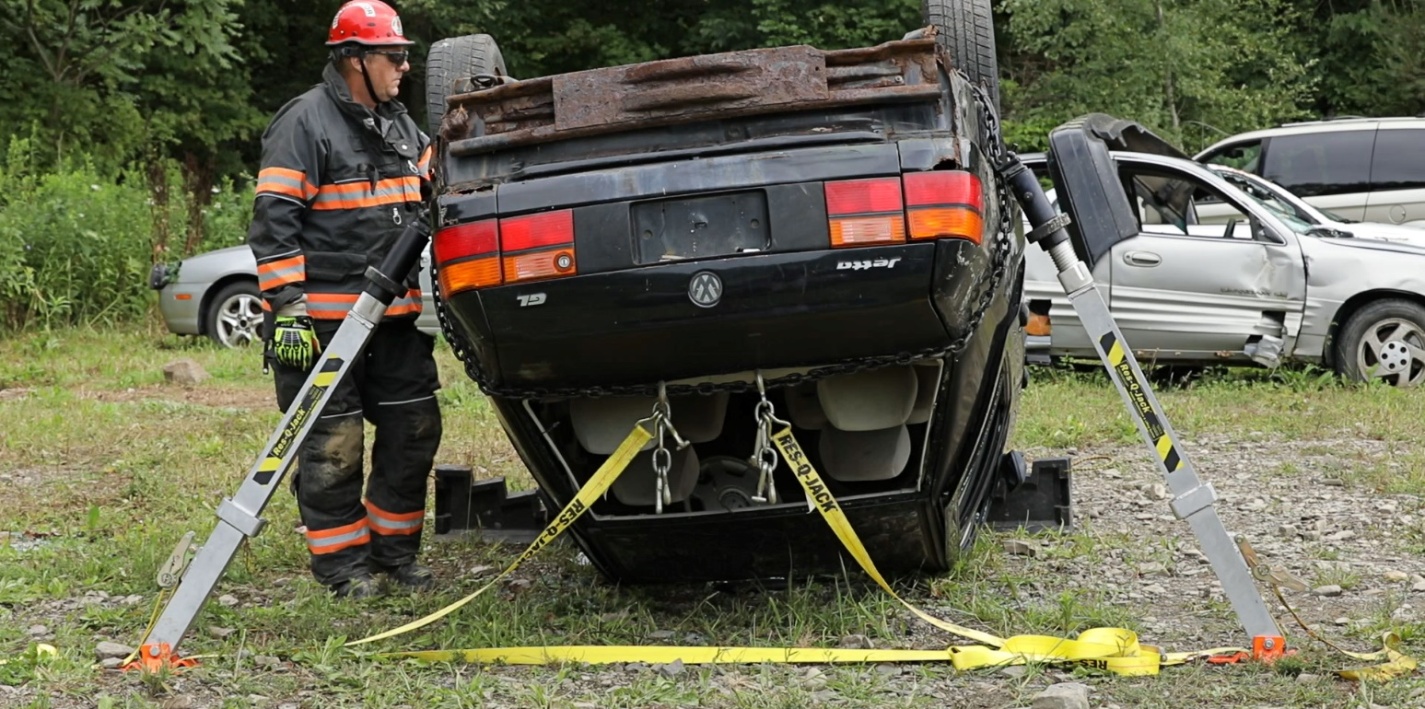
Lifting with Tension Management “Leash, sway or triangle” Technique
Leave slack in sway strap to allow for lift
Make sure ratchet mechanism in LOCKED position with multiple wraps on the bale
Tighten strap when lift is complete

Slide 55
Why do we keep triangle straps hooked low?
Before Lift
After Lift
CAR
CAR

Slide 56
Why is length helpful to keep vertical force in straps down?
Short lengths build tension quicker than longer lengths
Before Lift
After Lift

Slide 57
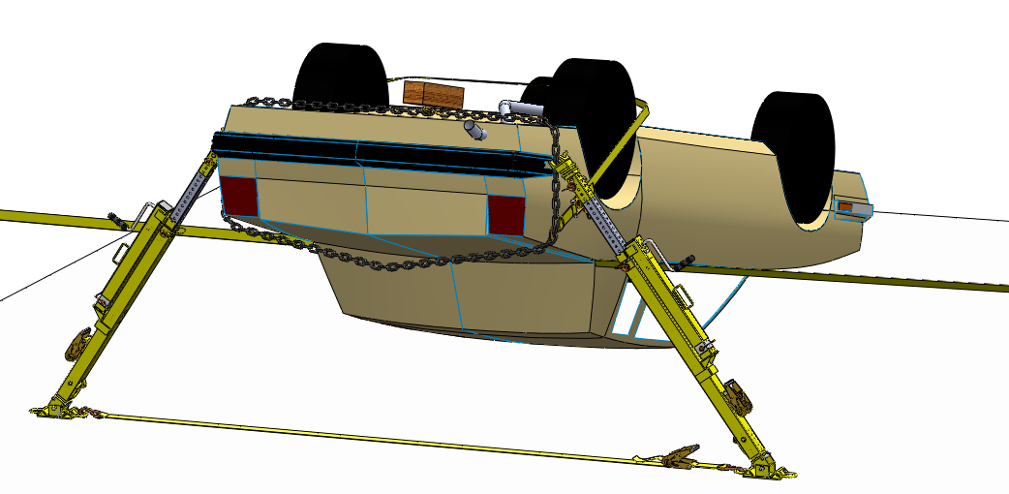
Lifting with Tension Management “Outrigger Alternative”
Using Base-to Base Strap

Slide 58
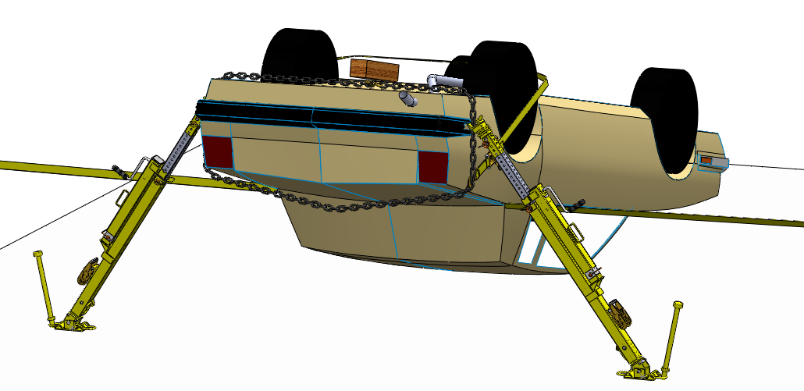
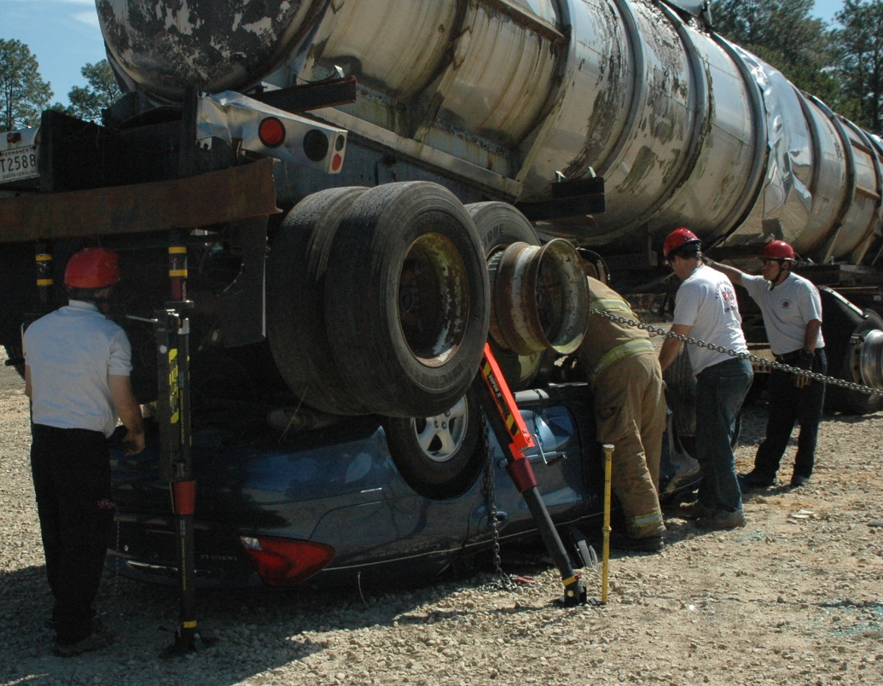
Lifting with Tension Management “Outrigger Alternative”
Using Staked Bases

Slide 59
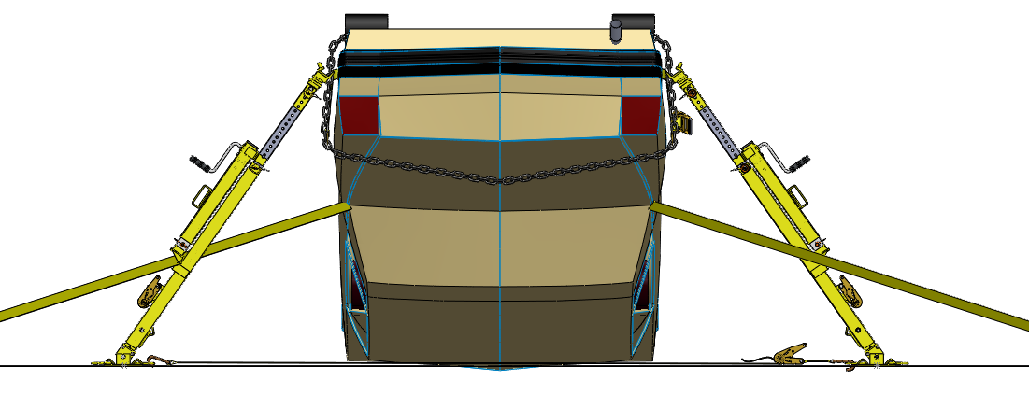
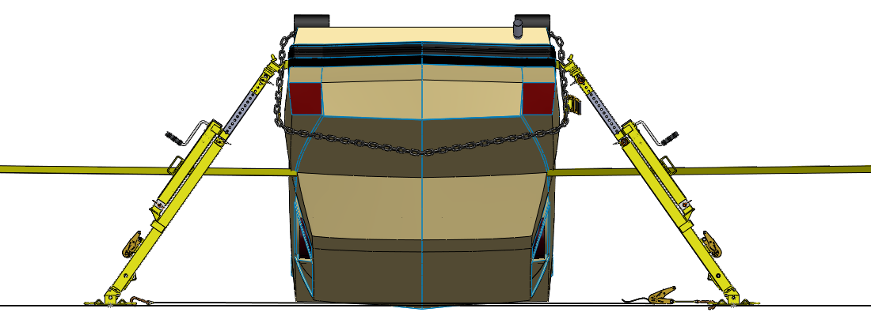
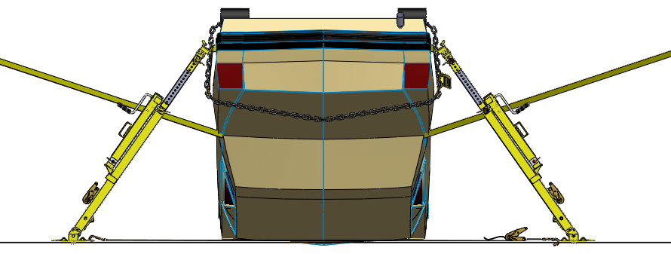
Understanding Outriggers
1. Tie line from a lower anchor point creates tension on straps while lifting
2. Flat strap with some length may not need adjustment
3. Tie line from a higher anchor point will create slack in straps and require tensioning as the lift progresses, which is easier compared to #1

Slide 60
Considering Strut Placement: Going Against Your Instinct
The ideal location for lifting might be in a position that could later interfere with extrication or access to the patient.
Lifting and stabilization can be broken down into 2 steps
1st Step: Lift from ideal location for simple operation.
2nd Step: Stabilize without interfering with extrication and remove interfering strut.
This may save time and produce a better, safer lift!

Slide 61
Critical Strut Feature
The load may require use of heavy duty lift bags. In this case, LIFTING struts with ability to follow the load up and down are a necessity that make for the safest lift.
In both cases, you want a strut that has infinitesimal length adjustment capability under the load without compromising user safety.
Ever tried to crib a load on the way down?

Slide 62
Overrides/Underrides
Tie suspension down when needed on lower and/or upper vehicle prior to lifting if suspension is going to impact lift, otherwise, there may be a delay in object separation as suspension expands maintaining contact with bottom object
Anchor upper and lower objects together in fashion that limits unwanted movement but allows desired movement/lift
In bottom left picture, notice left side of upper vehicle anchored to lower vehicles to create stable hinge point to allow safe lift of right side.
In bottom right picture, notice that the chain used for lifting also holds suspension from dropping which saves time and more equipment.

Slide 63
CONSTANT-STABILIZATION-LIFTINGTM Technique by Res-Q-Jack, Inc.
● The purpose of the technique is to keep the car stabilized during the entire lift (hence the name, Constant Stabilization Lifting).
Insert written explanation by Cris as to what it and why we’re using it. What are it’s pros and cons?

Slide 64
Wheel Resting CSLTM Lift
Follow instructions in Lift B from our Quick Reference Guide with the
following changes:
● Do not use the sway or triangle
straps on this initial set of struts.
Lifting Struts
Chasing Strut
● These initial struts will become the lifting struts that will follow the lifting struts.

Slide 65
● Add a 2nd set of struts parallel to
this initial set behind this pair of struts.
● Attach triangle or sway control
straps between the bases of these
struts and the vehicle along with an
optional base to base strap if possible.
● This 2nd set of struts will be the
stabilization or “chase” struts.
Start the lift with the initial set of lifting
struts.
Chasing Strut
Lifting Strut
● While lifting, the stabilization struts will begin to loosen. To maintain a stable lift, chase the lift with these struts. Do not lift or get ahead with the stabilization struts making sure that only the designated lifting struts are being used to lift.
- Note: base to base straps on our chase struts (if incorporated) will likely loosen. This can be tightened now or later in the lift.
● If the lift gets to a point where the struts begin to lean towards the front of the vehicle, you will need to attach a strap to the stabilization and possibly the lifting struts to the front of the vehicle.
● If space is needed and all straps are tight on the stabilization struts you can now remove the lifting struts and their components.
- Note: the bases of the stabilization struts may tilt up in the front as shown. Although not an issue, the tilt could be remedied with a base to base strap or you could utilize struts with on-board back- mounted straps that do not connect to base link.

Slide 66
Side Resting CSLTM Lift
Follow instructions in Lift C (side-resting front lift) from our Quick Reference Guide with the following changes:
● Once you have clearance underneath the front of the vehicle, set up a second set of struts including a base to base strap which will now become the lifting struts.
● The initial struts now become the stabilization or
“chase” struts. Resume lifting with the front set of
lifting struts while chasing the lift with our initial set
of struts.
● While lifting, the stabilization struts will begin to
loosen. To maintain a stable lift, chase the lift with
these struts. Do not lift or get ahead with the
stabilization struts making sure that only the
designated lifting struts are being used to lift from
this point on.
- Note: base to base straps on our chase struts (if incorporated) will likely loosen. This can be tightened now or later in the lift.

Slide 67
● If the lift gets to a point where the struts begin to lean towards the rear of the vehicle you will need to attach a strap to the stabilization struts and possibly the lifting struts to the rear of the vehicle.
Lifting Strut
Chasing Strut
● If needed, 1 set of struts may be removed if remaining set of struts have direct tieback from strut bases to vehicle forming triangles with tension. A base to base strap on this set of struts may not be necessary but is highly recommended.

Slide 68
Roof Resting CSLTM Rear Lift
● Follow instructions in Lift D (roof-resting rear lift) from our Quick Reference Guide with the following changes:
● Tighten sway straps without lifting.
-Note: base to base strap on
these initial struts is optional
but recommended.
● These initial struts
will become the
stabilizing or “chase”
struts that will follow
the lifting struts.

Slide 69
● Add a 2nd set of struts parallel to this initial
set in front of this pair of struts.
● Attach a base to base strap only (no
triangle or sway straps) of sufficient WLL.
● This 2nd set of struts will be the lifting
struts. Perform the lift using these struts.
● While lifting, the initial stabilization struts
will begin to loosen. To maintain a stable lift,
chase the lift with these struts. Do not lift or
get ahead with the stabilization struts making
sure that only the designated lifting struts are
being used to lift.
Note: Base to base straps
on the chase struts (if
incorporated) will likely
loosen. This can be tightened
now or later in the
lift.

Slide 70
● If the lift gets to a point where the struts begin to lean towards the front of the vehicle, you will need to attach a strap to the stabilization struts and possibly the lifting struts to the front of the vehicle.
Chasing Strut
Lifting Strut
● If space is needed and all straps are tight on the stabilization struts, you can now remove the lifting struts and their components to create more room for extrication.

Slide 71
Part IV:
Strut Lifting Scenarios

Slide 72
Wheel Resting Side Lift
Crib under both sides of vehicle.
Tie down suspension.
Check both front and rear wheels.
Place strut between A and B posts at 40-70° angle leaving 4” minimum between strut and door skin. Engage head with roof rail.
Hook large J-Hook to the roof rail near head of strut. Run chain across roof to the opposite side of the car. Hook ratchet strap to the end of this chain and pass the strap under the car to opposite side where the strut is placed.
Hook the strap to the base of the strut. Tighten until secure.
To lift, operate the jack. Lift an inch, crib an inch.
Note: Avoid side loading the strut!

Slide 73
Alternative Wheel Resting Side Lift
Alternate Setups:
Vertical strut w/ step chock.
Pictured to the left
Chain to Near Side
Run a chain from the undercarriage of the car and attach to the strut head using chain grab
No Roof Rail (Convertible)
Use the “Chain to Near Side” Technique
Use the Darlington Lift Technique

Slide 74
Wheel-Resting Rear Lift
Crib under both sides of vehicle.
Tie down suspension.
Check both front and rear wheels.
Place two struts on opposite sides close to the rear roof posts at 40-70° angle.
Connect the bases of the two struts with a ratchet strap and tighten.
Loosely attach sway straps from the strut bases to the undercarriage of the vehicle forming triangles. Ensure there are multiple wraps on the bale and the ratchet is in the locked position.
To lift, operate both jacks at the same time. Lift an inch, crib an inch. Tighten straps when lift is complete.
If patient interferes with a base-to-base strap, stake base of each strut

Slide 75
Alternative Wheel-Resting Rear Lift
Alternate Setups:
Substitute Stakes for Base-To-Base Strap
This replaces the base-to-base strap by connecting the struts through the ground
No Roof Rail (Convertible)
Use the “Chain to Near Side” technique.
Use the Darlington Lift technique.

Slide 76
Side-Resting Front Lift
Crib under both sides of vehicle. Use at least 4 wedges (2 on front, 2 on back)
Place strut at A post in the corner of windshield.
Connect J-Hook to the lower A post to create a base restraint.
Place second strut at the underside of the vehicle, opposite the first strut.
Engage the strut head with the frame or structurally sound area
Pull the chain to rear wheel assembly, remove slack and reconnect the chain using cluster
To lift, operate jacks at the same time. Lift an inch, crib an inch.
Caution: In this scenario, we are lifting using triangles. Keep straps at ground level and only use for short lift. If higher lift is desired, transition to alternate setup after clearance is created beneath vehicle.

Slide 77
Alternative Side-Resting Lifts
Rear-Lift
Back of the vehicle is lighter. Disadvantage is the weakness of the C Post.
Chain Wrap Around Hood or Rear
Wrap chain around hood or rear. Lift from chain at side of vehicle. Use opposing struts, one on each side.

Slide 78
Roof-Resting Rear Lift
Crib both sides of vehicle. Use tie lines as necessary to control all possible movement. Use a picket at each front corner to secure the vehicle if needed.
Wrap the chain around the vehicle near the rear of the trunk, removing slack and hooking the chain to itself at the high side of the vehicle.
To remove additional slack, slide the chain forward so the final position of the chain is tightly secure, centered between the wheel well and the rear of the trunk.
Place a strut on each side of the vehicle at the rear fender. Engage the end fittings with the chain wrap near the middle of the rear fender, as shown.
Connect the bases of the struts to each other with a ratchet strap; tighten to remove slack in chain.
Secure the chain from sliding off the vehicle by connecting a snap hook from a ratchet strap into a link of chain, below the strut engagement. Run the strap around the rear wheel. Use cribbing to protect the strap from sharp objects or hot exhaust. Connect the strap to the chain around the opposite wheel.
To lift, operate jacks at the same time. To control sway, tighten the secondary straps as needed. Lift an inch, crib an inch.

Slide 79
Alternative Roof-Resting Rear Lift
Alternative Setup:
3-Point Rear Lift
Use a 3rd strut at the rear of the vehicle. Attach 2 straps from the base of the 3rd strut to the bases of the first 2. One strap from each base of the original 2 to a forward point of the vehicle.
Improved 2-Point Rear Lift
With struts leaning slightly toward the front of the car, attach their bases to forward points of the vehicle and lift.

Slide 80
Alternative Roof-Resting Rear Lift
Outrigger Sway Control
Replace the sway straps with straps attached to remote picket.
Easier lift, better access to rear windshield.

Slide 81
Barrier Rear Lift
Option 1: Use Roof-Resting Rear Lift procedure
Option 2: Place 1 strut in back center of trunk, use tie-backs to control motion of vehicle

Slide 82
Barrier Controlled Roll
Use concepts in Wheel-Resting Side Lift
Strut options:
One Strut
-If you can get the strut near the center of the weight of the car (near the A-Post)
Two Struts

Slide 83
Dumpster Override
Goal: Lift top object and crib with enough room for roof removal
Use tie-lines, stakes
Strut Setup: Similar to Roof-Resting Rear Lift, with or without chain wrap. Struts opposite each other with base-to-base strap, adding triangles with ratchet straps
Alternate Setup: Use vertical struts under the dumpster by creating a purchase point with chain

Slide 84
Bus Overrides
Use vertical struts under the bus or leaning toward the bus (with base restraints)
Preventing Movement:
Stake bases and restrain bus by tie-lines
Ratchet straps from bases to underside of bus

Slide 85
Parallel Override
Options:
Front Lift on Upper Car
Rear Lift on Upper Car
Control Roll Upper Car

Slide 86
T-Bone Override
Use concepts from Wheel-Resting Side Lift and Parallel Override
Hinge Point: Side of car near cab of truck
Set up struts using chains to create purchase points
Restrain base plates or create triangles

Slide 87
Controlled Roll
In early 2000’s, we pioneered the controlled roll to speed up rescue operations
Controlled Roll is a lift force applied against a 2nd opposing lifting force which acts as a brake to control or limit the amount of movement allowed

Slide 88
Darlington Lift/Roll

Slide 89
Darlington Lift/Roll
Roof-Resting Car Wheel-Resting Car Concrete Slab

Slide 90
Tripod Setup

Slide 91
Other Scenarios

Slide 92
Other Scenarios

Slide 93
Part V:
Calculating Loads

Slide 94
Calculating Loads What’s it weigh?
Vehicle Type | Approx. Weight (lbs.)
Passenger Car – Compact | 2500
Passenger Car – Mid-Size | 3300
Passenger Car – Large | 3800
Mini Van | 3900
SUV – Standard Size | 4000
SUV – Large Size | 5600
Pickup – Small | 4000
Pickup – Standard | 4500
Pickup – Large | 6000
Steel | 489 per ft³
Concrete | 150 per ft³

Slide 95
Calculating Loads What’s it weigh?
Reference: http://thetruckersplace.com/BridgeFormula.aspx

Slide 96
Calculating Loads What’s it weigh?

Slide 97
Calculating Loads What’s it weigh?
How do we estimate weights of objects?
density X volume = weight
(lb./ft³) X (ft³) = (lb.)

Slide 98
Calculating Loads What’s it weigh?
Residential wood frame construction
Reference: https://www.bgstructuralengineering.com/BGASCE7/BGASCE7003/BGASCE700302.htm

Slide 99
Calculating Loads What’s it weigh?
Reference: http://web.engr.uky.edu/~gebland/CE%20382/CE%20382%20Four%20Slides%20per%20Page/L2%20-%20%20Loads.pdf

Slide 100
Calculating Loads What’s it weigh?
Reference: http://web.engr.uky.edu/~gebland/CE%20382/CE%20382%20Four%20Slides%20per%20Page/L2%20-%20%20Loads.pdf

Slide 101
Calculating Loads What’s it weigh?
Reference: http://www.charltonandjenrick.co.uk/news/2017/02/softwood-vs-hardwood/

Slide 102
Calculating Loads What’s it weigh?
Reference: https://cellcode.us/quotes/a-volume-of-cone-calculator.html

Slide 103
Calculating Loads What’s it weigh?
Many factors dictate the load a strut will experience
Ground contact, angle of load, weight of vehicle, weight of contents, number of struts, object center of weight…
In the left picture, more load is placed on the bottom vehicle vs. the right picture.
W
W
Fs
L / 5
L / 2
Fs
L
L
ΣM = 0
Fs x L = W x L / 2
Fs = W / 2
ΣM = 0
Fs x L = W x L / 5
Fs = W / 5

Slide 104
Part VII:
Wood Cribbing and Accessory Information

Slide 105
Wood Cribbing
Reference: (1) https://tr2fd.com/download/40/technical-rescue/2214/fema-crib-stack-limitations.pdf
(2) https://www.fema.gov/pdf/emergency/usr/module2a.pdf

Slide 106
Ratchet Straps, Chains, Etc.
Cam Strap: 700 lb. WLL
Snap Strap: 2000 lb. WLL
Double Wire Hook Strap: 3300 lb. WLL
Chain Strap: 3300 lb. WLL

Slide 107
Ratchet Straps, Chains, Etc.
Reference: https://baprod.com/_pdf/WLL-Label.pdf

Slide 108
Part VII:
RQJ Product/Equipment Overview

Slide 109
Super X-Strut®
Item # SPX-EX56 (Long Strut)
• Column WLL: 19,300 LBS.
• Lifting WLL: 6,000 LBS
• Extended Height: 100"
• Collapsed Height: 67.5"
• Weight: 46 LBS
Item # SPX-EX41 (Short Strut)
• Column WLL: 19,300 LBS.
• Lifting WLL: 6,000 LBS
• Extended Height: 68.5"
• Collapsed Height: 51.5"
• Weight: 36 LBS
*Able to add 36” of extension,
limited to two extensions.

Slide 110
Super X-Strut®

Slide 111
Apex X-Strut®
Item # APX-STRT-L (Long Strut)
• Column WLL: 7,750 LBS.
• Lifting WLL: 6,000 LBS
• Extended Height: 91.5"
• Collapsed Height: 58.75"
• Weight: 41 LBS
Item # APX-STRT-S (Short Strut)
• Column WLL: 12,500 LBS.
• Lifting WLL: 6,000 LBS
• Extended Height: 62.75"
• Collapsed Height: 45.125"
• Weight: 33 LBS
*Able to add 36” of extension,
limited to two extensions.

Slide 112
Apex X-Strut®

Slide 113
Auto X-Strut®
Item # ATX-STRT-L (Long Strut)
• Column WLL: 3,250 LBS.
• Lifting WLL: 2,500 LBS
• Extended Height: 88.25"
• Collapsed Height: 54.5"
• Weight: 33 LBS
Item # ATX-STRT-S (Short Strut)
• Column WLL: 3,250 LBS.
• Lifting WLL: 2,500 LBS
• Extended Height: 67"
• Collapsed Height: 44"
• Weight: 30 LBS
*Able to add 36” of extension,
limited to two extensions.

Slide 114
Auto X-Strut®

Slide 115
Aluminum X-Strut®
Item # ALX-STRT (Long Strut)
• Column WLL: 9,700 LBS.
• Lifting WLL: 6,000 LBS
• Extended Height: 98"
• Collapsed Height: 56"
• Weight: 42 LBS
Item # SAX-STRT (Short Strut)
• Column WLL: 9,700 LBS.
• Lifting WLL: 6,000 LBS
• Extended Height: 66"
• Collapsed Height: 40"
• Weight: 30 LBS
Item # ALX-STRT-PH (Phoenix)
• Column WLL: 9,700 LBS.
• Lifting WLL: 6,000 LBS
• Extended Height: 86.25"
• Collapsed Height: 50"
• Weight: 37 LBS

Slide 116
Aluminum X-Strut®

Slide 117
Steel X-Strut®
Item # STX-STRT (Long Strut)
• Column WLL: 4,000 LBS.
• Lifting WLL: 4,000 LBS
• Extended Height: 81.5"
• Collapsed Height: 53.5"
• Weight: 38 LBS
Item # SSX-STRT (Short Strut)
• Column WLL: 4,000 LBS.
• Lifting WLL: 4,000 LBS
• Extended Height: 59"
• Collapsed Height: 40"
• Weight: 27 LBS

Slide 118
Steel X-Strut®

Slide 119
RJ3 Jackstand
FEATURES
2:1 Safety Factor on strut, jack and accessories.
Integrated Jack provides 4,000 lbs. of built-in lifting power (2:1)
Modular Design allows for multiple configurations to suit your needs.
Rugged Steel Construction provides durability.
Pinned End Fittings allow you to easily swap out heads for your application.
Swivel CRG Head Fitting comes standard, allowing for a wide range of purchase points.
Base-Mounted D-Rings allow you to attach different straps or secure with stakes or pickets.
CAM Buckle Straps come pre-attached to the strut base for quick deployment.
18" Extension Tubing included with strut for alternate configurations.
RAM Configuration turns the strut into a short ram (with additional end fitting-see catalog).
Column WLL: 4,000 LBS.
Lifting WLL: 4,000 LBS
Extended Height: 106"
Collapsed Height: 52.5”
Weight: 53 LBS

Slide 120
SpaceSaver Jackstand
FEATURES
2:1 Safety Factor on strut, jack and accessories.
Integrated Jack provides 4,000 lbs. of built-in lifting power (2:1)
Modular Design allows for multiple configurations to suit your needs.
Rugged Steel Construction provides durability.
Pinned End Fittings allow you to easily swap out heads for your application.
Swivel CRG Head Fitting comes standard, allowing for a wide range of purchase points.
Base-Mounted D-Rings allow you to attach different straps or secure with stakes or pickets.
CAM Buckle Straps come pre-attached to the strut base for quick deployment.
Column WLL: 4,000 LBS.
Lifting WLL: 4,000 LBS
Extended Height: 103.5"
Collapsed Height: 36.5”
Weight: 54 LBS

Slide 121
GreenLite X-Strut®
Item # GLX-STRT (Long Strut)
• Column WLL: 2,500 LBS.
• Lifting WLL: 2,500 LBS
• Extended Height: 85.5"
• Collapsed Height: 54.25"
• Weight: 29 LBS*
Item # SGL-STRT (Short Strut)
• Column WLL: 2,500 LBS.
• Lifting WLL: 2,500 LBS
• Extended Height: 62"
• Collapsed Height: 42"
• Weight: 22 LBS*

Slide 122
GreenLite X-Strut®

Slide 123
Get involved— Follow and tag us on social media!
Facebook.com/resqjack
Instagram.com/resqjack_
#resqjack
youtube.com/user/ResQJack
twitter.com/ResQJack
#resqjack
Email info@res-q-jack.com for a copy of this presentation

